Slide 1
Detecting Deepfakes: A Machine Learning Approach
Deepfakes are a rapidly evolving technology that poses a significant threat to authenticity and trust. This presentation outlines a machine learning approach to detecting deepfake images, aiming to contribute to the development of reliable solutions.
Vidit Srivastava
E23CSEU0903
E23CSEU0903

Slide 2
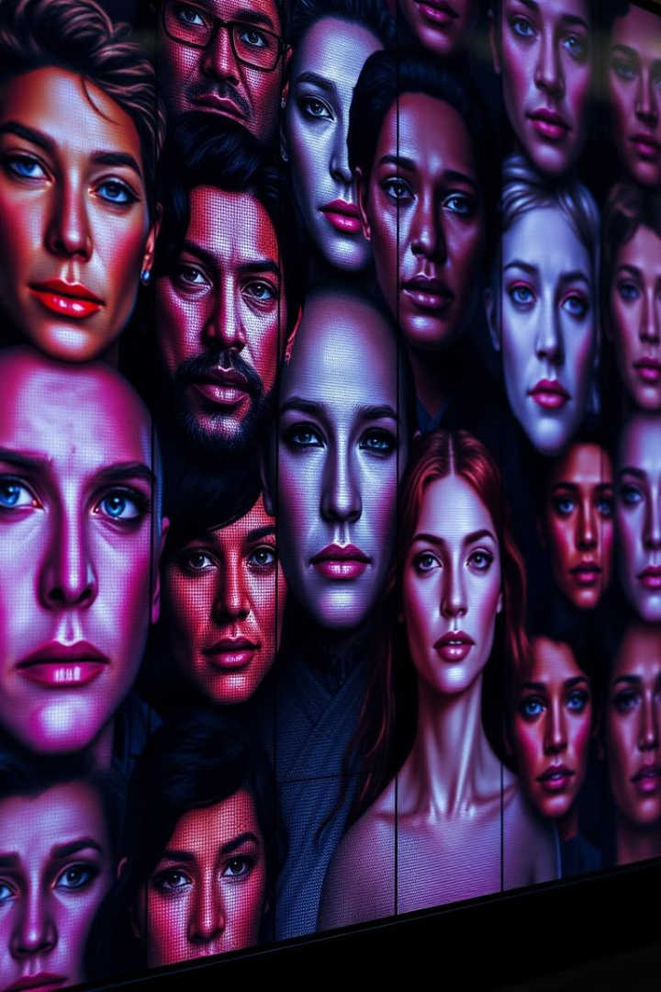
Introduction to Deepfakes
1
Synthetic Media
2
AI-Powered Manipulation
Deepfakes are synthetic media generated using artificial intelligence (AI) to create highly realistic, fabricated content.
Deepfakes leverage advanced machine learning algorithms to manipulate and synthesize existing media, often using facial recognition and generative adversarial networks (GANs).
3
Ethical Concerns
Deepfakes have raised ethical concerns due to their potential for misuse, including spreading misinformation, undermining trust, and damaging reputations.
E23CSEU0903

Slide 3
Project Objectives and Scope
Develop a Deepfake Detection Model
Leverage Machine Learning Techniques
Evaluate Model Performance
Create a machine learning model capable of distinguishing between real and deepfake images with high accuracy.
Employ advanced machine learning techniques, such as convolutional neural networks (CNNs), to extract features from images and train a classifier.
Assess the model's ability to detect deepfakes using appropriate metrics, such as accuracy, precision, and recall.
E23CSEU0903

Slide 4
Dataset Exploration and Preprocessing
Kaggle Dataset
Data Exploration
Preprocessing Techniques
A publicly available Kaggle dataset containing over 190,000 facial images, divided into real and deepfake categories.
Visualize the dataset using Matplotlib to analyze distribution, identify potential biases, and understand the characteristics of deepfakes.
Apply standard image preprocessing steps, such as resizing, normalization, and augmentation, to enhance the dataset for model training.
E23CSEU0903

Slide 5
Feature engineering with Numpy and Pandas
Numpy
NumPy is used for efficient array operations and mathematical computations on the image data.
Pandas is used for data manipulation, cleaning, and transformation to prepare the dataset for training.
Pandas
Extract relevant features from images, such as color histograms, edge detection, and texture analysis, using Numpy and image processing libraries.
Feature Extraction
E23CSEU0903

Slide 6
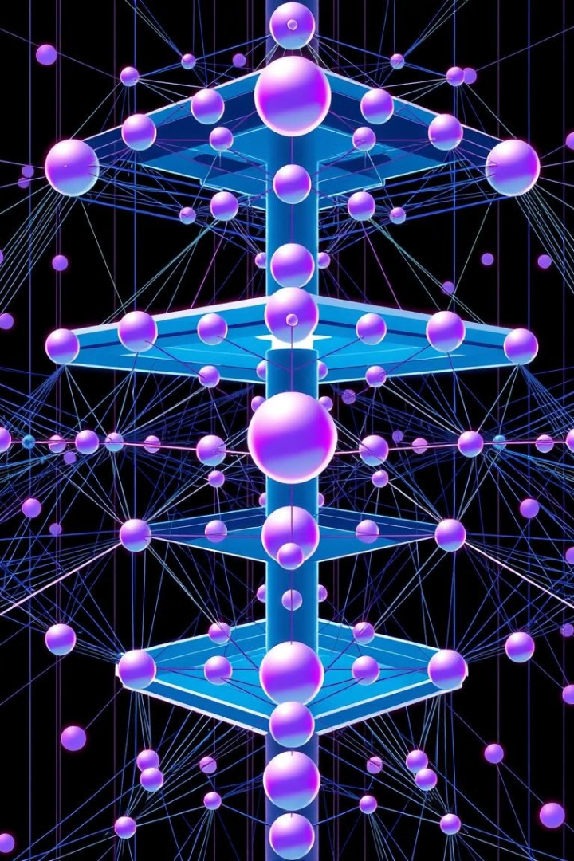



Model Architecture with TensorFlow and Keras
Convolutional Neural Network (CNN)
Utilize a CNN as the core model architecture, leveraging its ability to extract spatial features from images.
TensorFlow and Keras
Implement the CNN using TensorFlow and Keras, powerful deep learning frameworks that provide flexibility and efficiency.
Layers and Activations
Design the CNN with appropriate layers, such as convolutional layers, pooling layers, and fully connected layers, with suitable activation functions.
E23CSEU0903

Slide 7
Model Training and Evaluation
1
2
3
Training Data
Validation Data
Evaluation Metrics
Train the CNN model on the preprocessed dataset, allowing the network to learn the distinguishing features between real and deepfake images.
Monitor the model's performance during training using a validation set, ensuring generalization and preventing overfitting.
Evaluate the model's performance using relevant metrics, such as accuracy, precision, recall, and F1-score, to assess its effectiveness in detecting deepfakes.
E23CSEU0903

Slide 8



Prediction and Inference
New Image Input
The trained model can now be used to predict whether a new, unseen image is real or deepfake.
Classification Output
The model outputs a classification label (real or deepfake), along with a confidence score, indicating the likelihood of the prediction.
Real-Time Detection
The ability to perform real-time deepfake detection has significant implications for various applications, such as social media platforms and news organizations.
E23CSEU0903

Slide 9
Challenges and Limitations
1
Evolving Deepfake Technology
2
Data Availability and Quality
Deepfake techniques are constantly evolving, making it challenging to stay ahead of the curve in detecting them.
The availability of large and diverse datasets containing both real and deepfake images is crucial for training effective detection models.
3
Computational Resources
Training and deploying sophisticated deep learning models for deepfake detection require significant computational resources.
E23CSEU0903

Slide 10
Conclusion and Future Directions
This project has demonstrated the potential of machine learning for detecting deepfakes. Future research will explore advancements in model architecture, data augmentation techniques, and robust evaluation methods to address the challenges posed by deepfake technology.
E23CSEU0903

